Slide 1
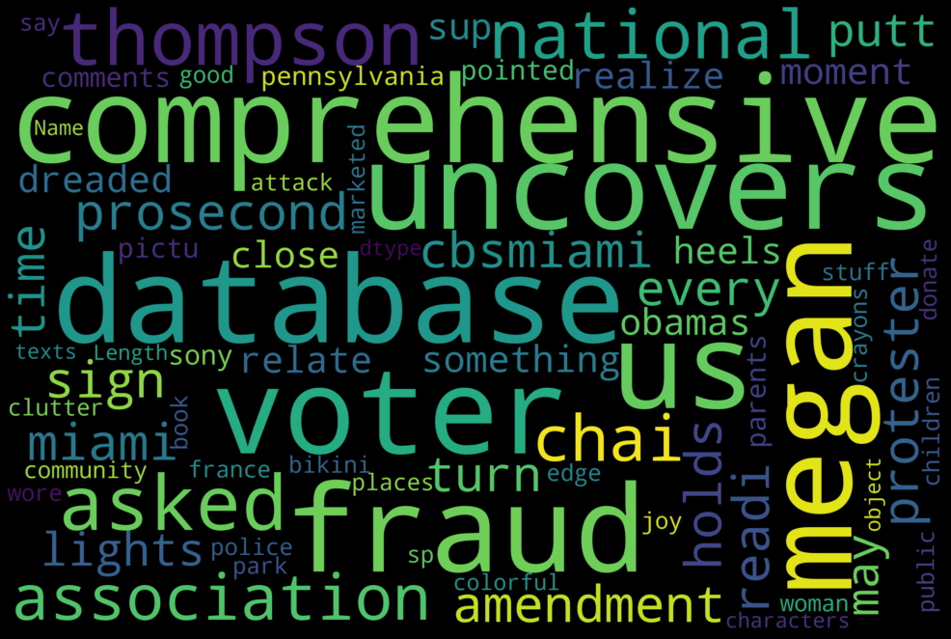

Fake News Analysis
Group 6
Ahmed Ibrahim Salem
Aliaa Faisal Kashwa
Ragia Hesham Aboutaleb

Slide 2
DataSet Description
In this project, a large dataset for fake news detection provided by using social media news and its related comments from Reddit.
The dataset consists of 69396 records (of which 74 percentage are labelled as real) by three different fact-checking sites (Snopes, PolitiFact and Emergent).
the dataset is in json format and each record in it is in textual format.
The dataset is available on Kaggle.

Slide 3
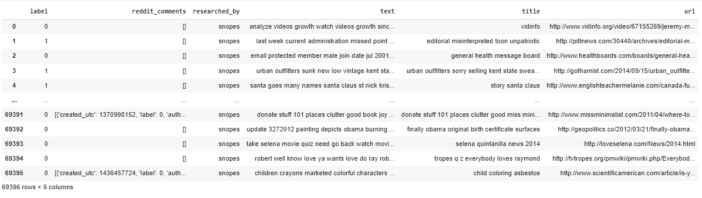
DataSet Description
This dataset has six columns,
Title: represent the title of each news.
Text: contain the body of the news itself.
Ridded_comments: contain the comments published on each news.
URL: contain the url of each news.
Researched_by: represent the name of the fact-checking site that checked the news.
Label: represent the label of each news whether it is fake (1) or real (0).

Slide 4
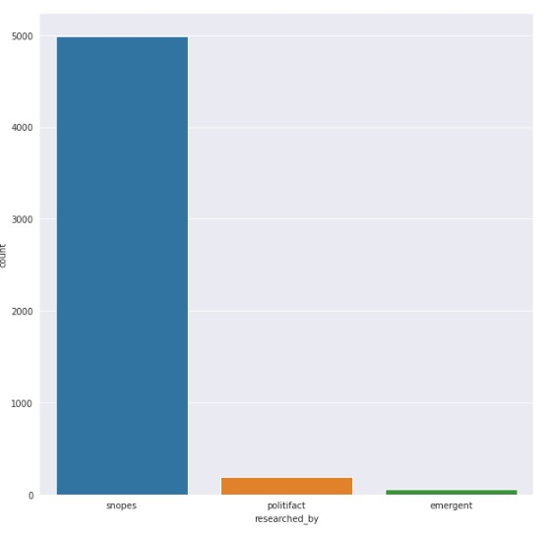
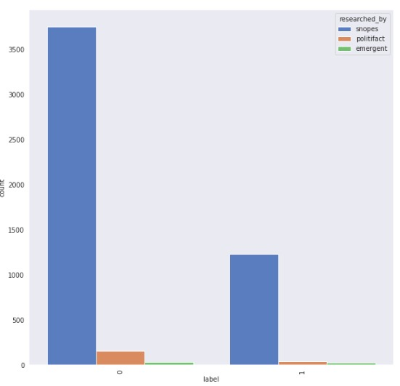
DataSet Description
From the first figure, the news checked by 3 fact-checking sites. We have the largest number of news from Snopes site.
Let us dig further into this in the second figure 2.

Slide 5

Data Preprocessing
For the text & url columns we made:
Expand Contractions
Lower Case
Remove Punctuations
Remove words and digits containing digits
Remove Stopwords
Stemming
Remove White spaces
Remove tags
For the riddet_comment column:
We removed the unwanted strings and white spaces.

Slide 6
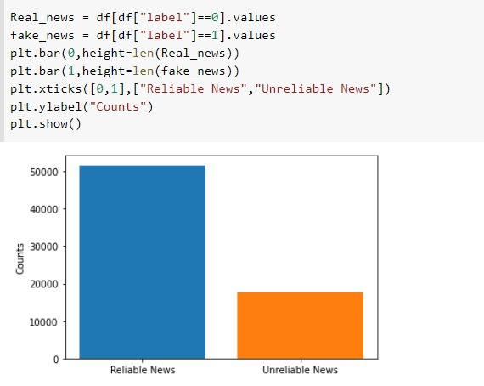
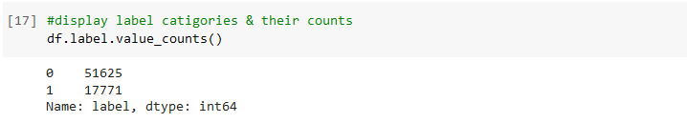
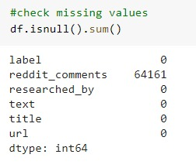
DataSet Statistics
After displaying data info, we observed that:
’label’ column has int datatype
and the other columns have object datatype.
After checking missing values, we observed that:
reddit comments has missing values that equal to 64161
the other column have 0 missing values.

Slide 7

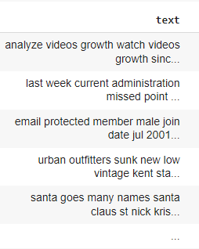
Data Preprocessing
In data processing, we will focus on the text column on this data which contains the news part.
We will modify this text column to extract features to make the model with acceptable performance.

Slide 8
1. First Question:
Is the ratio of fake news in Emergent fact-checking site significantly higher than the ratio of fake news by all other fact-checking sites?
Motivation:
The benefit of answering this question is helping the public using social media to determine which sites that are used to detect fake news are more credible than others.
Approach
Calculating ratio of news that checked by each fact-checking site are fake.
Findings:
From calculating the ratio for the 3 fact-checking sites, we found that:
The ratio for snopes is 0.25
The ratio for politifact is 0.166
And the ratio for emergent is 0.441
Emergent site significantly provide the highest ratio of fake news ,so emergent is pessimistic(comparing to the other sites) , when evaluating each news, because we expect to see almost similar ratio of fak news

Slide 9
2. Second Question
Predicting the number of user comments for each news.
Motivation:
The benefit of answering this question is helping knowing that which type of news users can interact with it and may be indicative of its importance or impact.
Approach:
We extracted the length of comments of each news as a new feature, then used it as label to predict later the expected number of comments on each news and applied this through 2 scenarios:
1- using the whole data ( 69396 rows) that has missing values in reddit_comments column assuming that the remained news have no comments (0)
2- using part of the data that has comments on each news without the ones that has missing values assuming that their comments are missed, so delete them, and use that 5235 rows to train/test our model.
Findings:
Until now we check the models to reach to the best performance

Slide 10
3. Last Question:
Predicting fake news with/without URLs.
Motivation:
The benefit of this question that, knowing the type of url whether it contain fake news or not. So, the user can distinguish between them. And that if the user know that the url was fake for one news we may predict that the other news that has the same link is also fake.
Approach:
We tried to predict fake news in two different scenarios:
1: predicting it by some features but url.
2: predicting it by the same some features including the url.
Findings:
Without using url feature , we obtained better performance for predicting the fake news than using it.

Slide 11
The res. Of first scenario with URL Feature:
Models | Test Accuracy
Logistic Regression | 78%
Multinomial Naïve Bayes | 79%
Passive Aggressive Classifier | 77%

Slide 12
The res. Of secound scenario Without URL Feature:
Models | Test Accuracy
Logistic Regression | 79%
Multinomial Naïve Bayes | 79%
Passive Aggressive Classifier | 79%

Slide 13
Limitations of our work:
Time taken by the models .
Ram required to train the models.
The quality of data that limits the model's accuracy to a specific range.

Slide 14
CONCLUSION
Fake news detection techniques can be divided into those based on style and those based on content, or fact-checking.
We handled the data and made several steps of preprocessing and displayed some results throw data exploration figures.
We answered 3 questions we proposed before throw several models and compared their performance .
We tried to use different models with hyper-parameter tuning to obtain better performance fore each model
Note:
Our recording in this link (https://calip.io/rnfuadzT#w3sAaKqU)

Slide 15


